Slide 1

NEWS HEADLINE CLASSIFICATION
Gokul Nagarajan
Karthik Selvaraj

Slide 2
OBJECTIVES
Classification of news articles using supervised Machine Learning (ML) and Natural Language Processing (NLP) techniques
Evaluate each classifier’s ability to select the appropriate category given an article’s title and a brief article description

Slide 3
WHY THE NEED FOR CLASSIFICATION OF NEWS?
There are numerous news sources, online news portals that are let out every minute of the daily operation.
News reports are relevant and flow everywhere, whether it's print media or electronic media
The news headlines will be used to train the model and the computer will be able to very easily and correctly predict the category of each news item later.
For all news channels and apps, this will be beneficial as it will give them an easy and speedy way to do their work

Slide 4
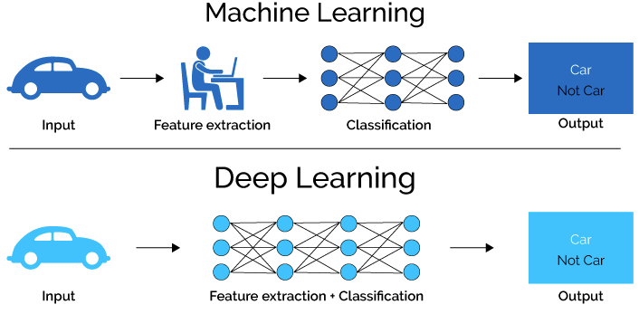
MACHINE LEARNING VS DEEP LEARNING
Machine learning is a subset of artificial intelligence associated with creating algorithms that can change themselves without human intervention
Deep learning is a subset of machine learning where algorithms are created and function similarly to machine learning, but there are many levels of these algorithms, each providing a different interpretation of the data it conveys. This network of algorithms is called artificial neural networks.

Slide 5
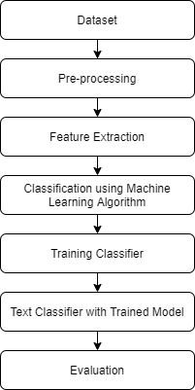
PROJECT PIPELINE

Slide 6
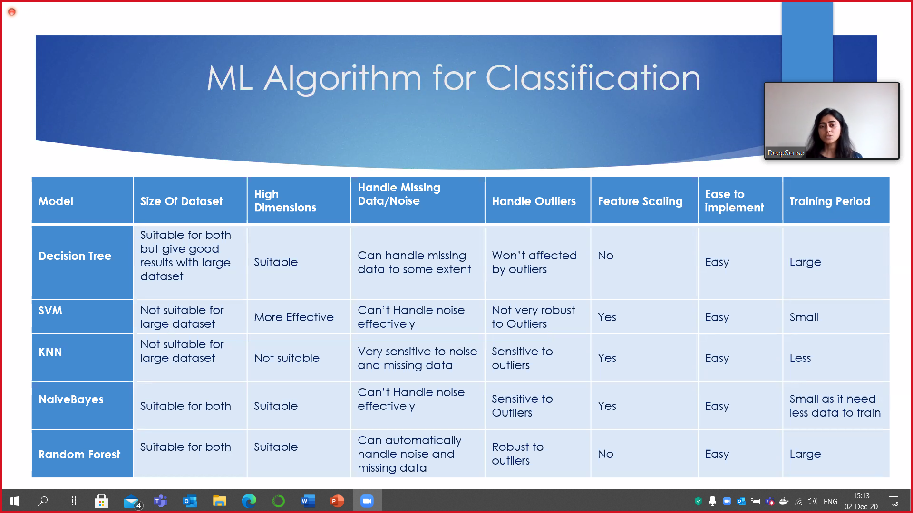
MODEL SELECTION

Slide 7
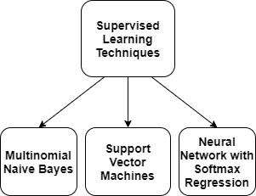
SUPERVISED LEARNING
Supervised classification of news articles is done because we have the defined classification categories.
The algorithm is trained on the labeled dataset and gives the desired output(the pre-defined categories)

Slide 8
MULTINOMIAL NAÏVE BAYES
The multinomial Naive Bayes implements the naive Bayes algorithm for multinomially distributed data and the classifier is suitable for classification with discrete features (e.g., word counts for text classification)
The multinomial distribution normally requires integer feature counts and fraction counts such as TF-IDF is used in practice.

Slide 9
SUPPORT VECTOR MACHINES
Linear SVC (Support Vector Classifier) is to fit to the data you provide, returning a "best fit" hyperplane that divides, or categorizes your data.
After obtaining the hyperplane, you can then feed some features to the classifier in order to acquire the "predicted" class.

Slide 10
NEURAL NETWORK WITH SOFTMAX REGRESSION
SoftMax layer is typically the final output layer in a neural network that performs multi-class classification.
SoftMax regression is a generalization of logistic regression that we can use for multi-class classification.

Slide 11
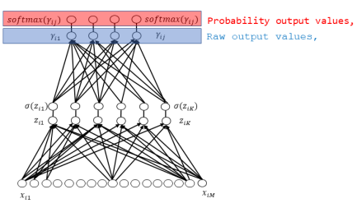
Neural network with softmax layer workflow mechanism

Slide 12
Programming LANGUAGE & PACKAGES USED
Python 3.0
NumPy
pandas
scikit-learn

Slide 13
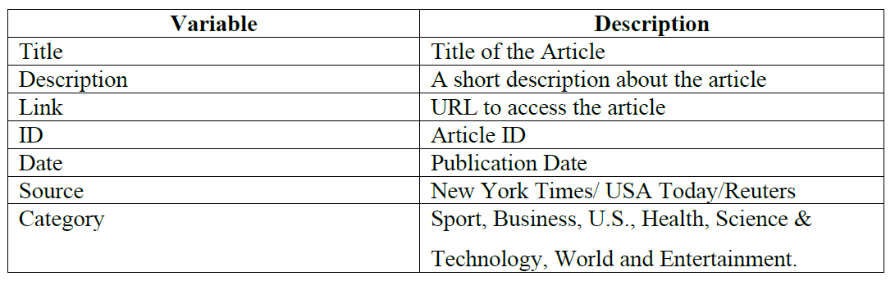
DATASET
TagMyNews Datasets is a collection of datasets of short text fragments that we used for the evaluation of our topic-based text classifier.
This is a dataset of ~32K English news extracted from RSS feeds of popular newspaper websites (nyt.com, usatoday.com, reuters.com).
Categories are: Sport, Business, U.S., Health, SciTech, World and Entertainment.

Slide 14
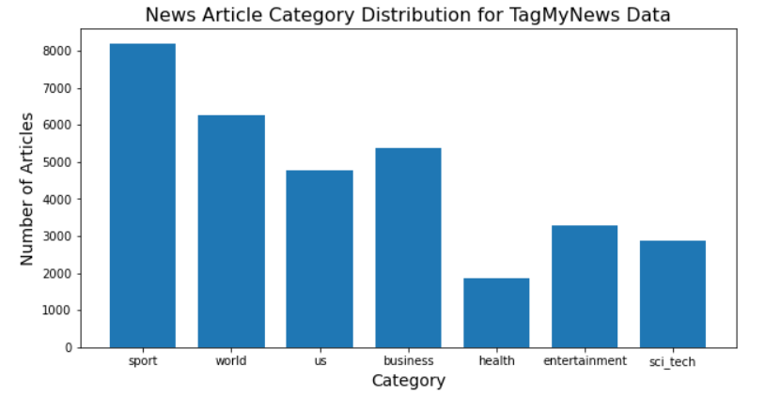
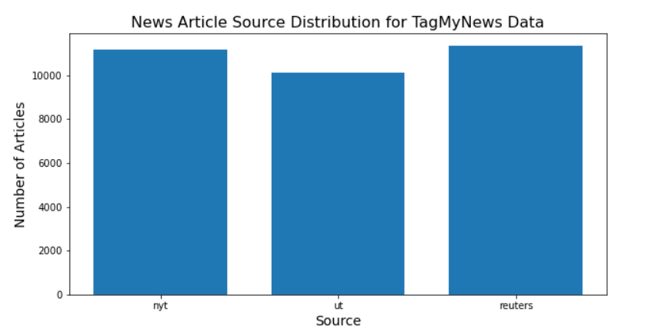
EXPLORATORY DATA ANALYSIS

Slide 15
DATASET PREPROCESSING
Pre-processing the news article data involved three steps.
First, we separated each article’s title, description, and pre-labeled category into a separate text file, since the corpus is formatted into a single file.
Second, we removed all punctuation and stopwords from the title and description.
We divided our data into training news articles and testing news articles. 75% of our data (24,453 articles) were designated as the training articles and the remaining 25% (8151 articles) were designated as the testing articles.

Slide 16

FEATURE EXTRACTION
TFIDF is a statistical measure that assesses how important a word is to a document in a series of documents. The TF-IDF weighting scheme will assign each term, t, a given weight in a document as follows:
where N is the number of documents. The weight is allocated by the product of t𝑓𝑡,𝑑, the term frequency, and log(N / d𝑓𝑡), the inverse document frequency.
TFIDFTransformer()
TFIDF transformer transforms a count matrix to a normalized tf or tf-idf representation (i.e., calculates the inverse document frequencies and it encodes the documents)
CountVectorizer()
The collection of text documents is converted to a matrix of token counts using count vectorize that produces a sparse representation of the counts.

Slide 17
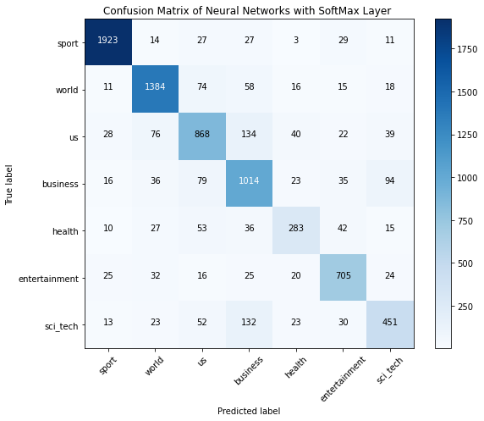

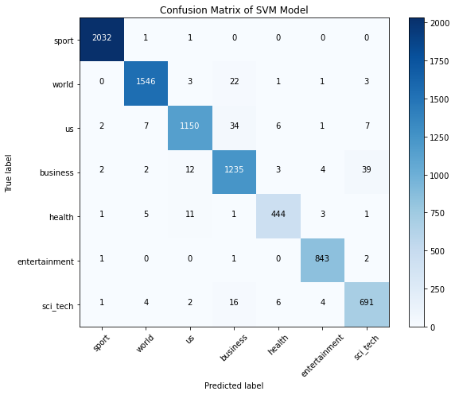
Confusion matrix

Slide 18
MODEL EVALUATION
To evaluate each classifier’s performance on individual classes, we used the three measurements derived from the confusion matrix: Precision, Recall, and F1-score.
Precision is the class agreement of the data labels with the positive labels given by the classifier.
Recall is the effectiveness of a classifier to identify positive labels.
The F1-score is the harmonic mean of precision and recall

Slide 19
PRECISION, RECALL & F1-Score FOR Naïve Bayes, NEURAL NETWORKS & SVM

Slide 20
SVM has the highest precision, recall & f1-score among all the three classifiers followed by Neural Networks with Softmax layer & Naïve Bayes classifier. Hence, Support Vector Machine classifier is highly suitable for classifying news article into their subject category in our case.
CONCLUSION

Slide 21
REFERENCES
1. Deb, N., Jha, V., Panjiyar, A. and Gupta, R. (2020). A Comparative Analysis of News Categorization Using Machine Learning Approaches. [online] Available at: http://www.ijstr.org/final-print/jan2020/A-Comparative-Analysis-Of-News-Categorization-Using-Machine-Learning-Approaches.pdf [Accessed 20 Oct. 2020].
2. Do, C.B. and Ng, A.Y., 2005. Transfer learning for text classification. Advances in neural information processing systems, 18, pp.299-306.
3. Hakim, A.A., Erwin, A., Eng, K.I., Galinium, M. and Muliady, W., 2014, October. Automated document classification for news article in Bahasa Indonesia based on term frequency inverse document frequency (TF-IDF) approach. In 2014 6th International Conference on Information Technology and Electrical Engineering (ICITEE) (pp. 1-4). IEEE.
4. Rana, M.I., Khalid, S. and Akbar, M.U., 2014, December. News classification based on their headlines: A review. In 17th IEEE International Multi Topic Conference 2014 (pp. 211-216). IEEE.

Slide 22
REFERENCES
5. Ruiz, M.E. and Srinivasan, P., 1998, October. Automatic text categorization using neural networks. In Proceedings of the 8th ASIS SIG/CR Workshop on Classification Research (pp. 59-72).
6.TagMyNews Datasets. Web.Archive.Org, 26 Apr. 2017, web.archive.org/web/20170426015149/acube.di.unipi.it:80/tmn-dataset/. Accessed 8th Oct. 2020.
7. Wang, Z.Q., Sun, X., Zhang, D.X. and Li, X., 2006, August. An optimal SVM-based text classification algorithm. In 2006 International Conference on Machine Learning and Cybernetics (pp. 1378-1381). IEEE.
8. Wu, H.C., Luk, R.W.P., Wong, K.F. and Kwok, K.L., 2008. Interpreting TF-IDF term weights as making relevance decisions. ACM Transactions on Information Systems (TOIS), 26(3), pp.1-37.
9. Youn, E. and Jeong, M.K., 2009. Class dependent feature scaling method using naive Bayes classifier for text datamining. Pattern Recognition Letters, 30(5), pp.477-485.

Slide 23
THANK YOU

